Slide 1




DIGITAL VERIFICATION
Full UVM Testbench for
AHB to APB Bridge Design
Supervisor Eng. Omar Younis
AHB to APB Bridge UVM Project

Slide 2
Agenda
1- Role of each member
2- Testbench Architecture
3- AHB Agent
4- APB Agent
5- Scoreboard
6- Assertions
7- Covergroups
8- Coverage Closure
AHB to APB Bridge UVM Project
2

Slide 3
Role of Each Member
Name | Primary Ownership | UVM Implementation
Marwa | AHB | AHB Agent
Abdelrahman | APB | APB Agent
Menna | Assertions + CDC + Reset | Top + reset + Assertions
Sameh | Bridge/Data Integrity | Env + Scoreboard + Reference Model + Tests
Roaa | Tests + Coverage Strategy | Sequences + Covergroups
AHB to APB Bridge UVM Project
3

Slide 4
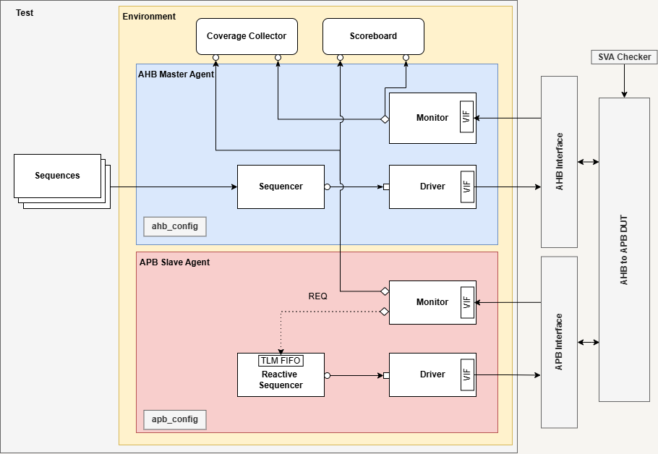
UVM Architecture
AHB to APB Bridge UVM Project
4

Slide 5

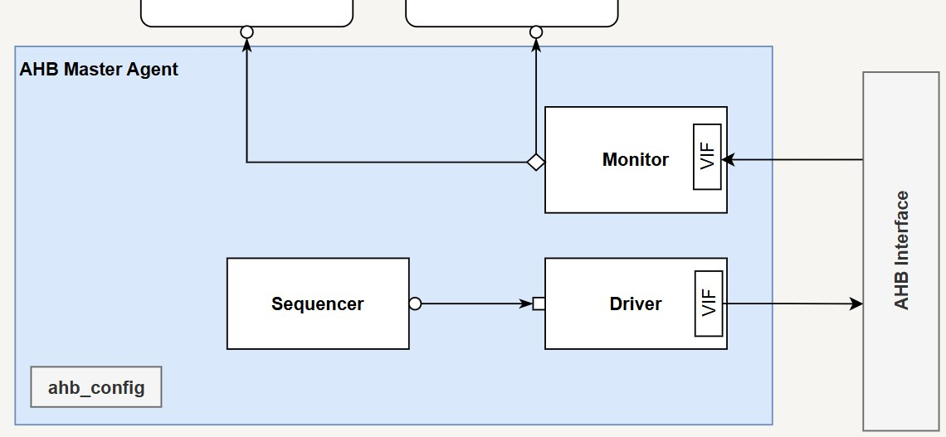
AHB Master Agent
1. Sequencer
Manages the delivery of AHB sequence items to the driver.
2. Driver
Drives AHB address & control and write-data signals, handles transfer handshaking and wait states, and captures read data and response status.
3. Monitor
Passively detects accepted AHB transfers, collects address/control and data/response information, counts wait states, and publishes completed transactions.
4. Configuration
Stores the AHB virtual interface and the active/passive mode, allowing the agent and its components to access shared configuration.
5. AHB Interface
Defines the AHB signals and driver/monitor clocking blocks to coordinate signal driving and sampling on HCLK
AHB to APB Bridge UVM Project
5

Slide 6
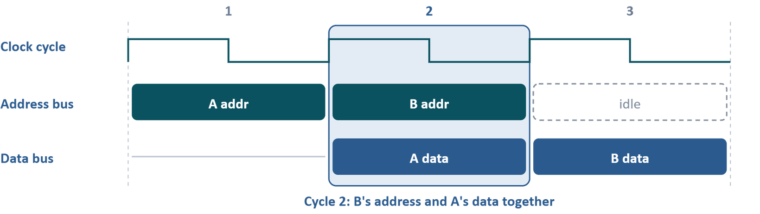
AHB Driver
Driver's Job
The driver takes ahb_item transactions from the sequencer and drive them on the ahb interface.It keeps the AHB pipeline full, so the address of the next transfer goes out while the data of the current one is still on the bus. It holds everything when the slave pulls HREADY low, stores HRDATA and HRESP back into the item, and handles reset
Two transfers, A then B. In cycle 2 the bus carries B's address while A's data is still on the bus, so the driver keeps track of two transfers at once.
AHB to APB Bridge UVM Project
6

Slide 7
AHB Driver
addr_item
The transfer whose address is on the bus now
data_item
The transfer whose datais on the bus now
Every clock cycle
Reset?
Abort: item_done on the open item, clear both boxes, initialize the bus.
Drive the address
try_next_item, then drive_addr.
No item? drive_idle.
Drive the data
If data_item is a write, put its HWDATA on the bus.
Wait for the clock
@(drv_cb), then look at HREADY.
need an item?? try_next_item never blocks, so the bus sees an idle cycle instead of a stall
AHB to APB Bridge UVM Project
7

Slide 8
AHB Driver
HREADY decides
HREADY = 1
Slave accepted the phase.
addr_item: if HTRANS[1], it becomes data_item (wait_states = 0). item_done, clear addr_item.
HREADY = 0
Slave is stalling.
Hold everything on the bus. addr_item stays non-null, so it is driven again next cycle.
data_item: wait_states++.
Boxes only move forward on HREADY = 1, so a stall never loses or reorders a transfer
AHB to APB Bridge UVM Project
8

Slide 9
AHB Monitor
Catch the address
HREADY, HSEL and HTRANS[1] all high: create an item (current_item) with HADDR, HWRITE, HTRANS, HSIZE, HPROT. then mark it as pending_item.
Count the stalls
While HREADY = 0 the data phase is not finished: wait_states++.
Publish it
HREADY = 1: fill HWDATA, HRDATA, HRESP and wait_states, then ahb_aport.write(pending_item).
Reset drops pending_item and clears wait_states. One item goes out per completed transfer
AHB to APB Bridge UVM Project
9

Slide 10
AHB Interface
Clocking block
Synchronizes signal driving and sampling with the AHB clock (HCLK).
drv_cb: Controls when the driver drives signals and samples responses.
mon_cb: Allows the monitor to sample AHB signals consistently.
Helps avoid race conditions between the testbench and DUT.
AHB to APB Bridge UVM Project
10
AHB to APB Bridge UVM Project

Slide 11
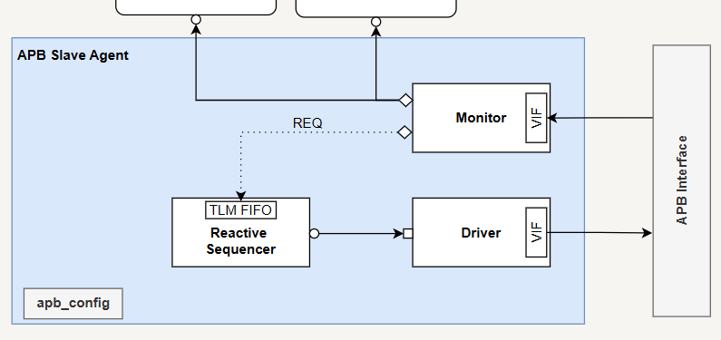
APB Agent
Slave responder
The DUT acts as APB master.
The agent answers it by driving
PREADY, PRDATA and PSLVERR.
Reactive
The DUT acts as APB master.
The agent answers it by driving
PREADY, PRDATA and PSLVERR.
AHB to APB Bridge UVM Project
11

Slide 12
APB Agent
Component
Class
Job
Config
apb_config
is_active flag and virtual apb_if
Monitor
apb_monitor
Samples request and completed transfer
Sequencer
apb_sequencer
Stores requests in request_fifo
Driver
apb_driver
Drives the slave response signals
Sequence
apb_sequence
Waits for a request, then randomizes a response
AHB to APB Bridge UVM Project
12

Slide 13
APB Agent
Reactive data flow
1
2
3
4
Monitor
Sequencer
Sequence
Driver
Detects setup phase (PSEL=1, PENABLE=0) and publishes the request on request_aport.
request_export feeds request_fifo inside the sequencer.
Gets one request, creates apb_response, and randomizes it.
Takes the response access phase at(PSEL=1, PENABLE=1) with get_next_item and drives it on the bus.
AHB to APB Bridge UVM Project
13

Slide 14
APB Transaction Classes
sequence_item (observed)
apb_response (random)
Request fields: PADDR, PWRITE, PWDATA, PSTRB,
PPROT, PSEL, PENABLE, APBACTIVE.
Filled at completion: PRDATA, PSLVERR, wait_count.
PRDATA (32 bits), PSLVERR, and wait_cycles constrained inside [0:5]. This is what the sequencer hands to the driver.
AHB to APB Bridge UVM Project
14

Slide 15
Driver and monitor timing
  Driver waits on posedge PCLK until PSEL and PENABLE are both high (access phase).
2. It holds PREADY low for wait_cycles clock cycles.
3. It sets PREADY=1 with PRDATA and PSLVERR for one cycle, then clears them.
4. The monitor counts cycles with PREADY low, then publishes the finished item on transaction_aport.
5. A clocking block in apb_if times all sampling and driving to the clock, which removes the race between the .. testbench and the DUT.
AHB to APB Bridge UVM Project
15

Slide 16
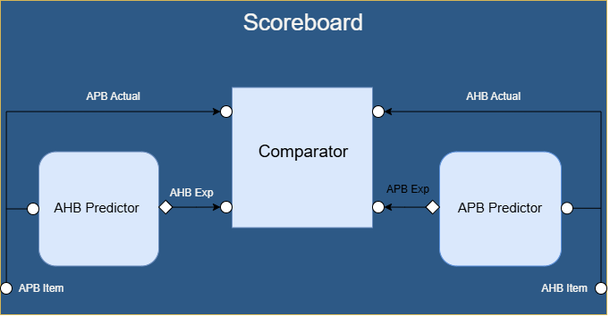
Scoreboard & Golden Model
AHB to APB Bridge UVM Project
16

Slide 17
Scoreboard structure
1. Inputs
2. Predictors
3. Comparator
Two analysis exports: ahb_aexport and apb_aexport, fed by the agents
ahb_prd and apb_prd turn each observed transaction into the expected one
Matches expected against actual, counts passes and failures, prints a report
AHB to APB Bridge UVM Project
17

Slide 18
AHB Predictor
Expected AHB | Taken from APB
HREADYOUT | PREADY
HRESP | PSLVERR
HRDATA | PRDATA
  Every APB item produces one expected AHB item, sent through ahb_exp_aport.
AHB to APB Bridge UVM Project
18

Slide 19
APB Predictor
Expected APB | Mapping
PADDR | HADDR[15:2]
PWRITE / PWDATA | Copied from HWRITE / HWDATA
PPROT | Remapped from HPROT bits
PSEL | HSEL and HTRANS[1]
PSTRB | From HSIZE and HADDR[1:0] on writes, else 0
  Only items with PSEL high are sent on to the comparator.
AHB to APB Bridge UVM Project
19

Slide 20
Comparator
Collect
Compare
Report
Four analysis FIFOs: expected and actual, for AHB and for APB
run_phase takes one item from each FIFO and calls compare on each pair
Pass and fail counts with pass rate per bus, then an overall verdict
19
AHB to APB Bridge UVM Project
20

Slide 21
Assertions
1. Phases legality
2. AHB to APB tracking
SETUP/ACCESS legality, PREADY completion, signals stable during wait states
No phantom or duplicate APB request for an accepted AHB transfer
  CDC handshake
4. Data and response
HRDATA = PRDATA, HRESP = PSLVERR, PWDATA = HWDATA on writes, APBACTIVE high when needed
Four req/ack ordering checks ported from the DUT OVL assertions to SVA
AHB to APB Bridge UVM Project
21

Slide 22
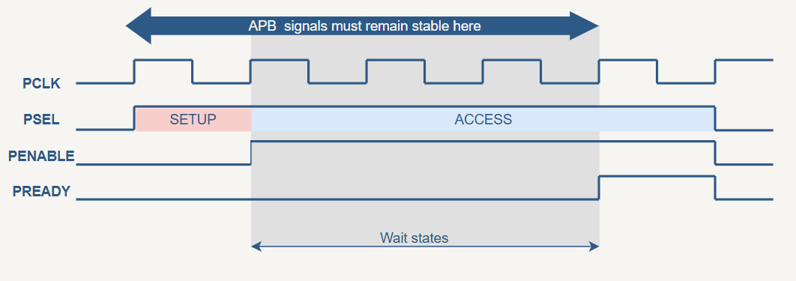
Assertions - phases legality
  $rose(PSEL) |-> !PENABLE
  PENABLE |-> PSEL
  apb_setup |=> (apb_access and p_apb_ctrl_stable)
  (apb_access && !PREADY) |=> apb_access
  (apb_access && !PREADY) |=> p_apb_ctrl_stable
  apb_done |=> !PENABLE
AHB to APB Bridge UVM Project
22

Slide 23
Assertions - AHB to APB tracking
the bridge must preserve a one-to-one relationship between accepted AHB transfers and APB transfer starts, even though the two interfaces use different clocks.
  APB SETUP needs a pending AHB request
apb_setup |-> (apb_start_cnt < ahb_acc_cnt)
AHB Counter
@(posedge HCLK)
ahb_acc_cnt
if ( ahb_accept)
ahb_acc_cnt ++;
Compare Counters
APB Counter
@(posedge PCLK)
apb_start_cnt
if ( apb_setup)
apb_start_cnt ++;
  When the AHB side completes (HREADYOUT = 1) the counters must match.
$rose(HREADYOUT) |-> (apb_start_cnt==ahb_acc_cnt)
AHB to APB Bridge UVM Project
23

Slide 24
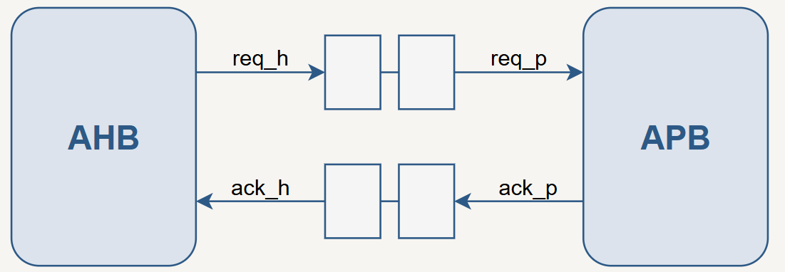
Assertions - CDC Handshaking
  Req may only rise when Ack is low
$rose(s_req_h) |-> !s_ack_h)
  Req may only fall when Ack is high
$fell(s_req_h) |-> s_ack_h)
  Ack may only rise when Req is high
$rose(s_ack_p) |-> s_req_p)
  Ack may only fall when Req is low
$fell(s_ack_p) |-> !s_req_p)
AHB to APB Bridge UVM Project
24

Slide 25
Assertions - Data & Response
Check | What is verified
Read data | HRDATA equals the last APB read data (OKAY responses only)
Response | HRESP equals the last PSLVERR when the transfer completes
Write data | On APB writes, PWDATA equals the last accepted AHB write data (reads are not checked)
APBACTIVE | High whenever req and ack differ, and whenever PSEL=1
AHB to APB Bridge UVM Project
25

Slide 26
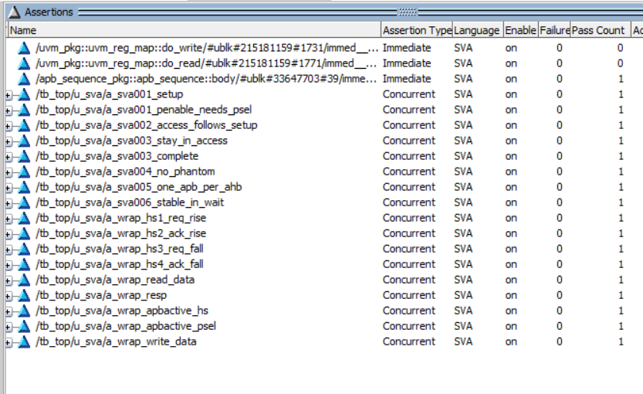
Assertions Results
AHB to APB Bridge UVM Project
26

Slide 27

AHB Transfer Coverage
CG-001–004, CG-009–010 | Coverage of AHB request attributes
Transfer attributes
Address regions
Protection attributes
HWRITE: READ / WRITE
LOW
MID
HIGH
HPROT[1:0]
HTRANS: NONSEQ / SEQ
0000–5555
5556–AAAA
AAAB–FFFF
BIN
BIN
BIN
BIN
HSIZE: BYTE / HALFWORD / WORD
00
01
10
11
Read/Write × Transfer Size | Cross coverage
Each cell is a required combination
The cross combines:
• 2 transfer directions
• 3 supported transfer sizes
• 6 total combinations
BYTE
HALFWORD
WORD
READ
Covered combination
Covered combination
Covered combination
WRITE
Covered combination
Covered combination
Covered combination
AHB to APB Bridge UVM Project
27

Slide 28
APB Transfer Coverage
CG-005–008, CG-013 | Strobes, completion, response and latency
PSTRB patterns
APB response
Observed APB byte enables.
PSLVERR
PSLVERR
NO STROBE
BYTE 0
BYTE 1
BYTE 2
OKAY | 0
ERROR | 1
0000
0001
0010
0100
BYTE 3
HALFWORD LOW
HALFWORD HIGH
FULL WORD
PREADY = 1 at published completion
1000
0011
1100
1111
SETUP: PSEL = 1, PENABLE = 0
Transfer latency | wait_count bins
NO WAIT
ONE WAIT
2–3 WAITS
4+ WAITS
wait_count = 1
wait_count = 2
wait_count = 3–4
wait_count = 5+
AHB to APB Bridge UVM Project
28

Slide 29
End-to-End Cross Coverage
CG-011, CG-012 | Link the AHB request attributes to the APB outcome
Read/Write × APB response
Read/Write × Wait × Response
Sampled only after an AHB/APB pair is matched
Three dimensions create 8 combinations:
OKAY
ERROR
DIRECTION
×
Goal: exercise every observed combination of transaction direction, APB latency category, and response status.
READ / WRITE
READ
Combination bin
Combination bin
LATENCY
×
NO WAIT / WAIT
WRITE
Combination bin
Combination bin
RESPONSE
OKAY / ERROR
Cross coverage is sampled only for address-matched pairs.
Transaction pairing check
The component compares AHB HADDR[15:2] with APB PADDR[15:2] before sampling the cross groups.
AHB to APB Bridge UVM Project
29

Slide 30
Coverage Exclusions
Waived item | Type | Justification
Synchroniser enable (both instances) and its all-false branch | Toggle, branch | Tied to 1 in design
HSIZE[2] | Toggle | Maximum data width is 32 bits
PPROT[1] | Toggle | Always 0 in the RTL mapping
PADDR[1:0] | Toggle | always “00”, APB address is always word-aligned
FSM default branches and illegal state (both FSMs) | Line, FSM state | Unreachable default / illegal encodings
Unaligned-address branches | Line | Unaligned transfers are not legal AHB stimulus
AHB to APB Bridge UVM Project
30

Slide 31
Coverage Closure: Added Tests
Reset while an AHB transfer is in flight
Reset in APB SETUP / ACCESS phase
Reset on one side only
(HRESETn or PRESETn)
HPROT, HTRANS different values
AHB to APB Bridge UVM Project
31

Slide 32
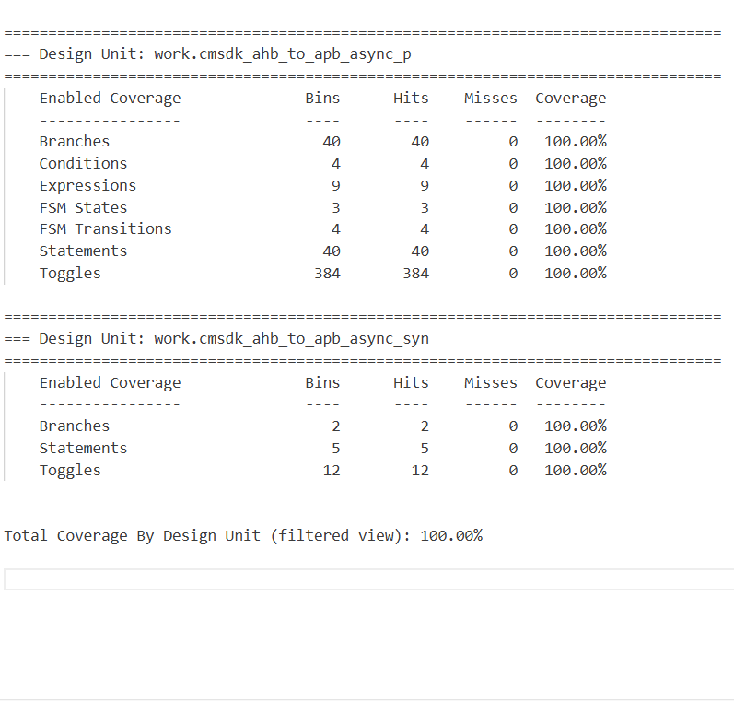
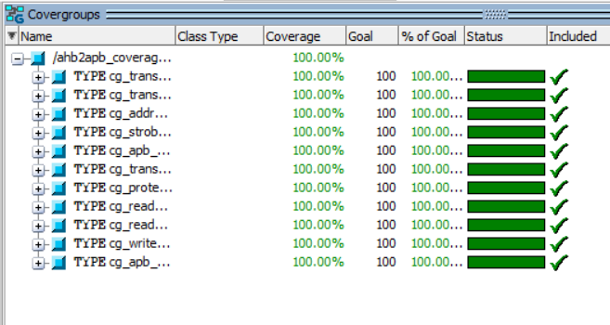
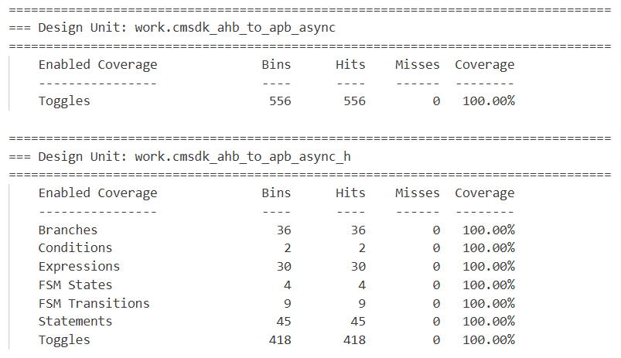
Coverage results
AHB to APB Bridge UVM Project
32

Slide 33
Thank You
Any Questions?
AHB to APB Bridge UVM Project
33

